Slide 1
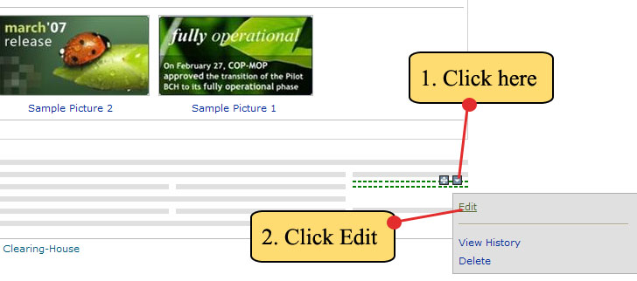
5.6 Adding more modules to a page
Step 2. Click on the icon. Now, the content module menu will appear, then click EDIT. The content editor page will then appear on screen.

Slide 2
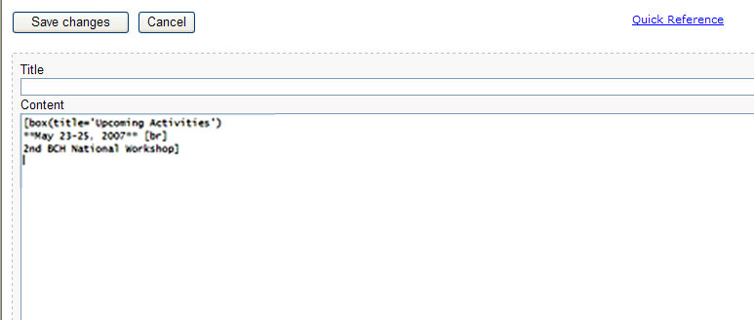
5.6 Adding more modules to a page
Step 3. Using the content editor page, type the following:
Title: - left blank -

Slide 3
5.6 Adding more modules to a page
Step 3. Using the content editor page, type the following:
Content:
[box(title='Upcoming Activities')
**May 23-25, 2007** [br]
2nd BCH National Workshop]

Slide 4

5.6 Adding more modules to a page
Step 4. Then click on Save Changes button.
CLICK HERE

Slide 5
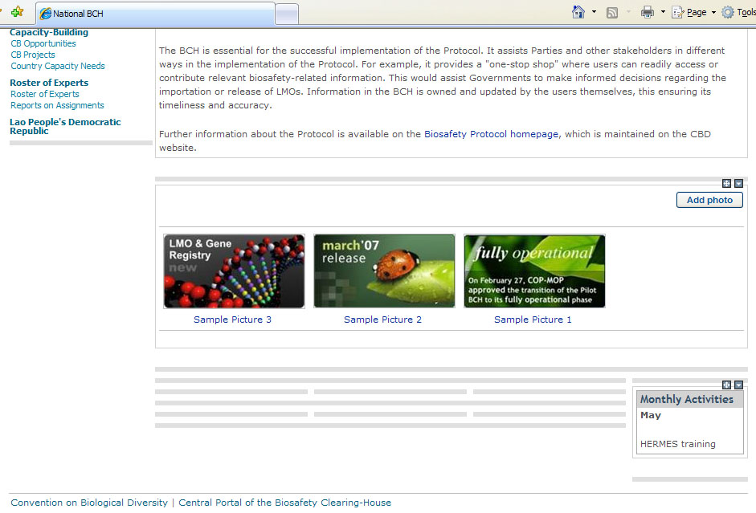
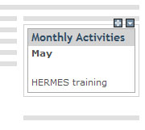
5.6 Adding more modules to a page
The NBCH index page will reappear with the new data included as shown.
FINAL OUTPUT

Slide 6
5.7 Moving content modules
Content modules can be moved using drag-and-drop.
Also content modules can be moved from one page to another one using two browser windows.
Content modules can be dragged using the icon visible at the top-right corner of each module.

Slide 7
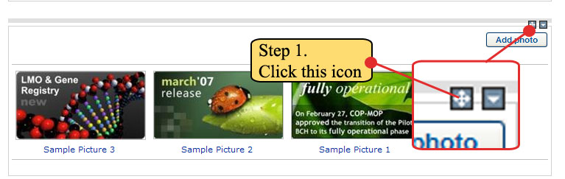
5.7 Moving content modules
Example. To demonstrate moving of modules, the photo gallery module will be placed on the left of the right column module that was created in the previous example.
Step 1. Click the icon visible at the top-right corner of the photo gallery module.

Slide 8
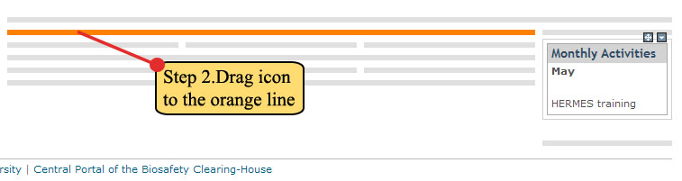
5.7 Moving content modules
Step 2. Drag the icon to the line beside the Monthly Activities module. An orange line will appear once the icon is over the desired line where the Photo Gallery will be moved.

Slide 9
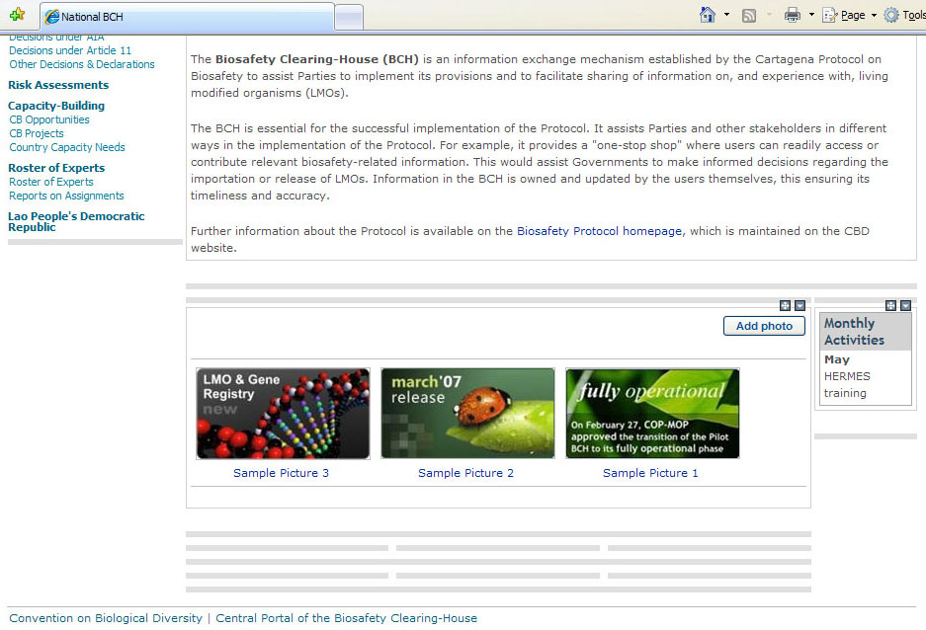
5.7 Moving content modules
Step 3. Release the icon. Shown is the final output.

